Slide 1





||Jai Sri Gurudev||
Sri Adhichunchanagiri Shikshana Trust®
ADHICHUNCHANAGIRI INSTITUTE OF TECHNOLOGY
(An ISO 9001: 2008 Certified)
Affiliated to Vishvesvaraya Technological University (VTU), Belagavi,
Approved by AICTE, New Delhi, Jyothinagar, Chikkamagaluru-577102
DEPARTMENT OF ARTIFICIAL INTELLIGENCE AND MACHING LEARNING
PROJECT PHASE -1[BAI685] Progress Seminar
On
IOT-BASED DEEP LEARNING COLLISION AVOIDANCE
SYSTEM FOR MULTIHAZARD ROAD SAFETY
Under the guidance Of:
Presented by:
Mrs.Sathyabhama R B.E, M.Tech.,
Assistant Professor,
Dept. of AIML,
AIT, Chikkamagaluru
Akshay K R (4AI23AI002)
Ayesha (4AI23AI005)
Ayesha Siddiqha (4AI23AI006)
Thanishka M (4AI23AI058)

Slide 2

Abstract
Introduction
Literature Survey
Motivation
Problem Statement
Objectives
Scope of the Project
Hardware and Software Requirements
System Design
Detailed Design & Algorithm Tracing
Implementation(Algorithm and Pseudocode
Results and Discussion
Conclusion & Future Work
References
AGENDA

Slide 3

ABSTRACT
Existing systems in the Intelligent Transportation and Road Safety domain use deep learning models such as CNN and YOLO for detecting road hazards and providing driver alerts. These AI and IoT-based solutions mainly focus on single-hazard detection without real-time collision risk prediction.
The Proposed system, the Artificial Intelligence and Smart Transportation domain, implements a YOLOv8-based multi-hazard detection and emergency braking alert system that performs real-time hazard detection, distance estimation, and collision risk prediction with alert notifications using minimal IoT hardware.

Slide 4

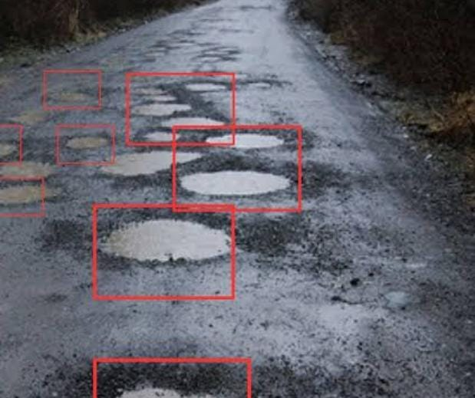

INTRODUCTION
Detecting Potholes:
Potholes are detected using the YOLOv8 deep learning model with computer vision for real-time road hazard detection.
The system analyzes camera frames using bounding box detection and highlights potholes on the dashboard for distance estimation and driver alerts. .

Slide 5
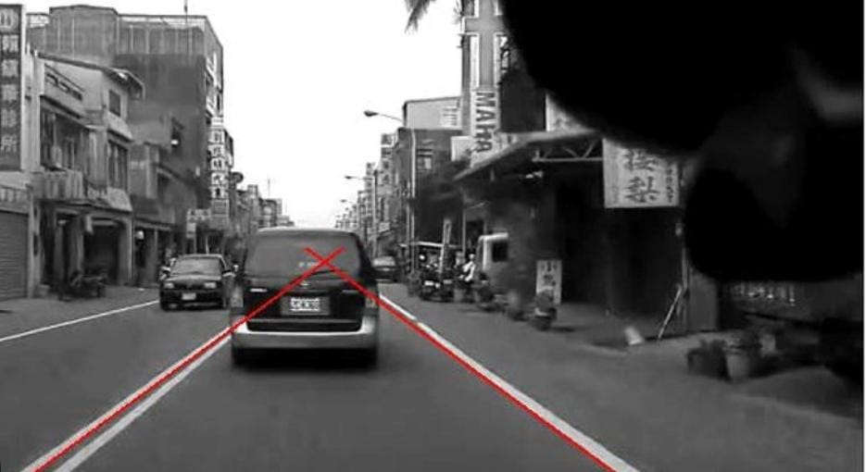
Edge Detection:
Performed using Canny Edge Detection with OpenCV to enhance object boundaries and improve detection accuracy.
It highlights road features like potholes and speed breakers by detecting intensity changes, helping the deep learning model identify road surface irregularities..

Slide 6
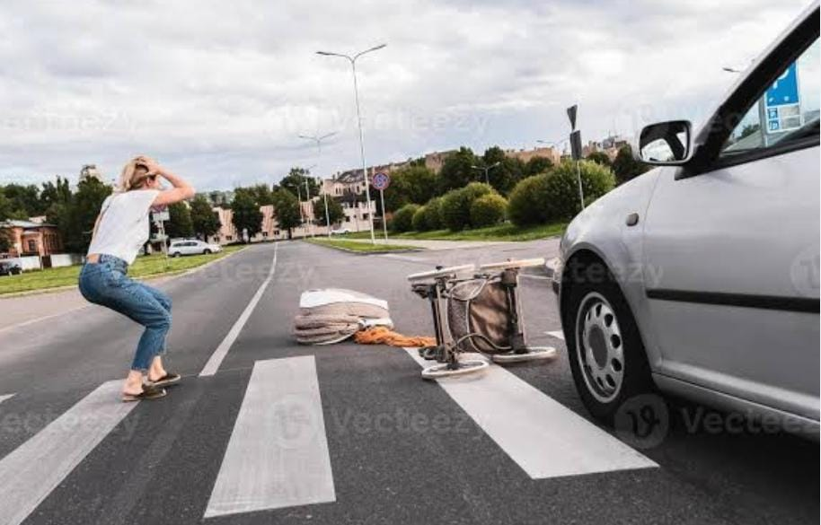
Pedestrian Detection:
Pedestrians are detected using the YOLOv8 real-time object detection model with deep learning.
The system processes camera video frames and identifies pedestrians using bounding box detection.If a pedestrian appears near the vehicle path, the system generates a warning or emergency alert for driver safety.

Slide 7
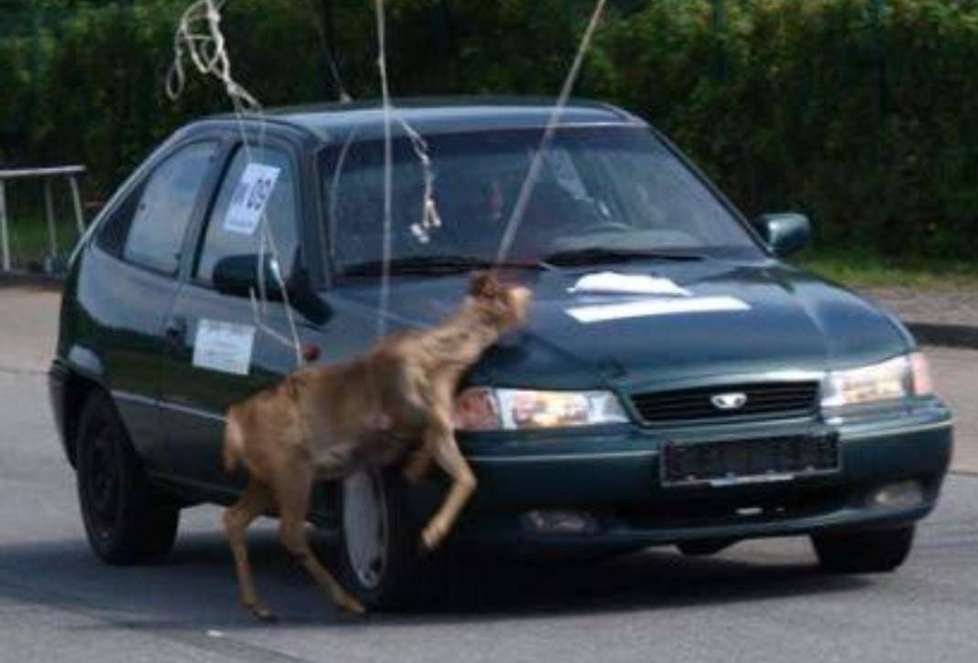
Animal Intrusion Detection:
Animal intrusion is detected using the YOLOv8 and Convolutional Neural Networks (CNN) for real-time object classification from camera frames.
When an animal enters the vehicle path, the system generates a warning alert to prevent possible collisions.

Slide 8
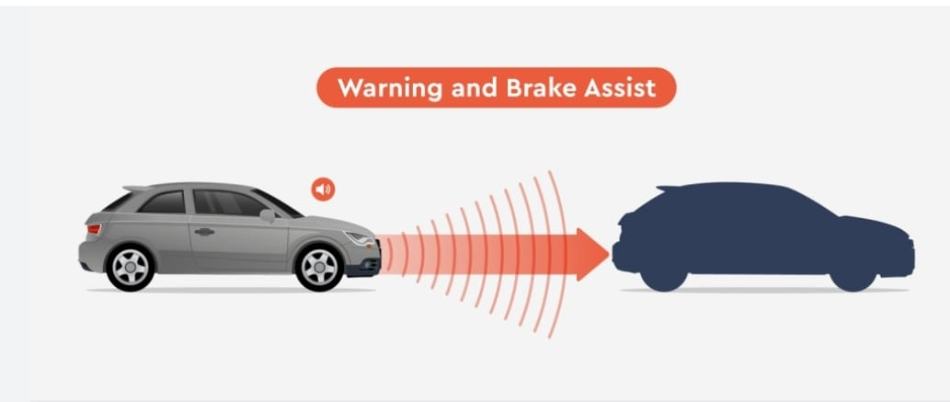
Automatic Braking Alert (Simulation):
Automatic braking is simulated using AI-based collision prediction and distance estimation to analyze detected road hazards.
When an object is within a critical distance, the system triggers an emergency brake alert on the dashboard and activates a buzzer warning for driver safety.

Slide 9
LITERATURE SURVEY
Sl.no | Author | Title | Proposed Method | Pros | Drawbacks
01 | Kunapareddy Bhavana, Kondapalli Divya Bhavani, Angadi Swathi Siva Reddy Vanga [2023] | Automatic Pothole and Humps on Roads Detection and Notification Alert | Ultrasonic sensor (HC-SR04) + GPS + GSM for depth/height measurement and SMS alerts | Low-cost prototype; real-time GPS location sharing; reduces manual inspection costs | Noise/weather interference; limited range accuracy
02 | Ranjitha R, Archana K, Sankalp, Sandesh B K, Shashank [2024] | Detection of Real Time Pothole System using Edge Detection | Canny edge + morphological ops on Pi camera; ultrasonic depth; 98% accuracy | High accuracy (98%); edge device deployable (RPi); live video support | Lighting/angle sensitivity; dataset dependency; manhole confusion
03 | Hongxu Chai, Shilong Zeng, Cheng Zhang [2024] | Enhanced Real-time Pavement Damage Analysis Integrating CNN Edge Detection with YOLO | CNN-YOLO + Laplacian edge + min-filter; >90% acc on RDD2020 | Multi-damage classification (cracks/potholes); fast FPS; high P-SNR (50dB) | Compute-intensive edges; poor original size estimation; mobility limits

Slide 10

Sl.no
Author
Title
Proposed Method
Pros
Drawbacks
04 | Naeem Raza, Ahmad Razzaq, Wahab Noman, Abdul Rehman , Aized Amin Soofi [2025] | A Deep Learning Based Real-Time Vehicle Detection... for Foggy Environment | YOLOv8n/s (mAP50 85%); TFLite Android collision avoidance | Fog-robust (106 FPS); mobile deployment; multi-vehicle classes | Overfits small datasets; distant/occluded objects weak​
05 | Mingyang Xu, Chen Xu, Gengxin Qi, Ming Yue, Xudong Zhao [2023] | Dynamic Obstacle Avoidance... Via Improved Artificial Potential Field | APF road/obstacle fields + MPC tracking | Adapts dynamic speeds; vehicle stability constraints; smooth paths | Needs precise env modeling; high-speed yaw limits

Slide 11


MOTIVATION
A recent accident in Hassan district claimed the life of Priya, an MCA final-year student, after a vehicle lost control on a speed breaker, highlighting the need for real-time road hazard detection and warning systems.
Reference link:
https://youtu.be/mUyTmW7NMQo?si=XwVH2Kquthbyb149
Modern vehicles are becoming smarter, but many affordable cars still lack advanced driver assistance features, creating a gap in safety technology for everyday users.
Driver fatigue or distraction during long drives reduces attention, increasing the need for intelligent real-time alert systems.

Slide 12
PROBLEM STATEMENT
The
Speaker
Circle
“To design an AI-based real-time road hazard detection and emergency braking alert system using computer vision and deep learning to detect potholes, speed breakers, pedestrians, animals, and vehicles and provide timely warning alerts for safer driving.”
Input:
Real-time video frames from camera
Processing:
★ Image Pre-processing:
  Capture video frames and resize them using OpenCV image resizing techniques.
  Apply image normalization and histogram equalization to enhance image quality and improve detection accuracy.
★ Edge Detection:
  Apply Canny Edge Detection to highlight road boundaries and surface irregularities.

Slide 13
★ Hazard Detection:
  Use YOLOv8 model to detect road hazards such as potholes, speed breakers, pedestrians, animals, and vehicles.
★ Distance Estimation:
  Calculate approximate distance using bounding box size and object scaling.
★ Collision Risk Analysis:
  If distance > 4 m → Safe
  If distance 2–4 m → Warning alert
  If distance < 2 m → Emergency brake alert (simulation)
Output:
Displays detected hazard, distance, and alert status on a live dashboard

Slide 14


OBJECTIVES
To collect and prepare a dataset of road hazards such as potholes, speed breakers, pedestrians, animals, and vehicles.
To detect road hazards using computer vision and deep learning techniques.
To estimate the distance between the vehicle and detected hazards and analyze collision risk in real time.
To generate warning or emergency brake alerts and display hazard detection information on a live dashboard

Slide 15
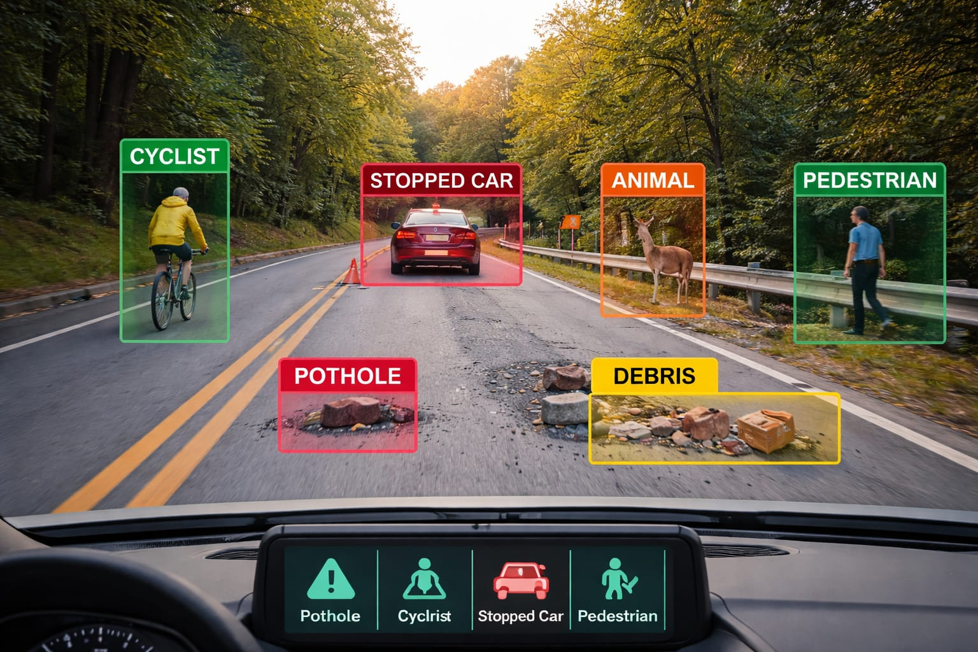
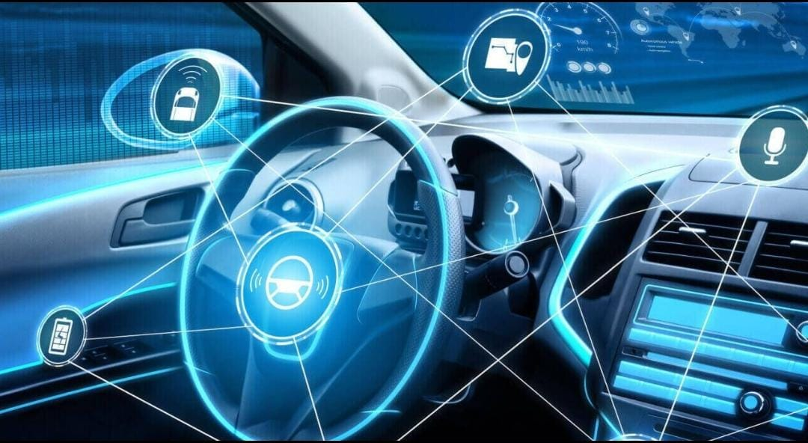
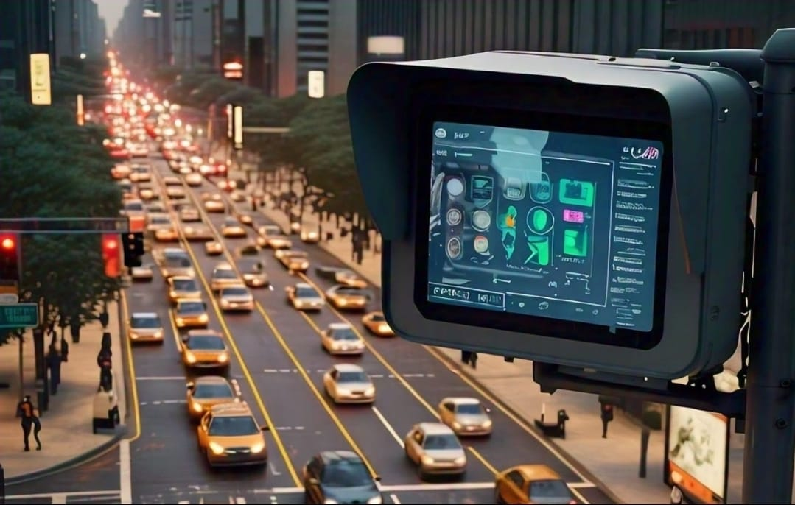
SCOPE OF THE PROJECT
Real-Time Hazard Detection
Advanced Driver Assistance Systems (ADAS) Integration
Highway & Urban Traffic Monitoring

Slide 16
HARDWARE AND SOFTWARE REQUIREMENTS
Hardware Requirements
Software Requirements
Processor | 12th Gen Intel Core i5
Memory | Minimum 8GB RAM
GPU | Minimum NVIDIA GTX 1050
Storage | Minimum 512GB SSD
Controller | Raspberry Pi
Camera | Pi Camera Module
Alert Device | Buzzer / LED
Operating System | Windows 11 / Ubuntu (64-bit)
Programming Language | Python
Deep Learning | YOLOv8
Computer Vision | OpenCV
Tools | PyTorch, Jupyter Notebook
Dashboard | Python-based monitoring system

Slide 17
SYSTEM DESIGN
Real-Time Road Video Stream
(Camera Module)
Auto Brake System
(Motor Control / Brake Trigger)
Output
Display Hazard, Distance & Alert Status
Image Preprocessing
(Noise removal, resizing, frame extraction)
Multi-Hazard Detection (YOLOv8)
• Pothole
• Speed Breaker
• Animal intrusion
• Edge detection
• pedestrian detection
IoT Module
(ESP32 / Raspberry Pi)
Driver Alert System
(Buzzer / Display)
Distance Estimation
Collision Risk Prediction
(Safe / Warning / Critical)
Figure 1: Block Diagram of Multi-Hazard Road Safety System

Slide 18
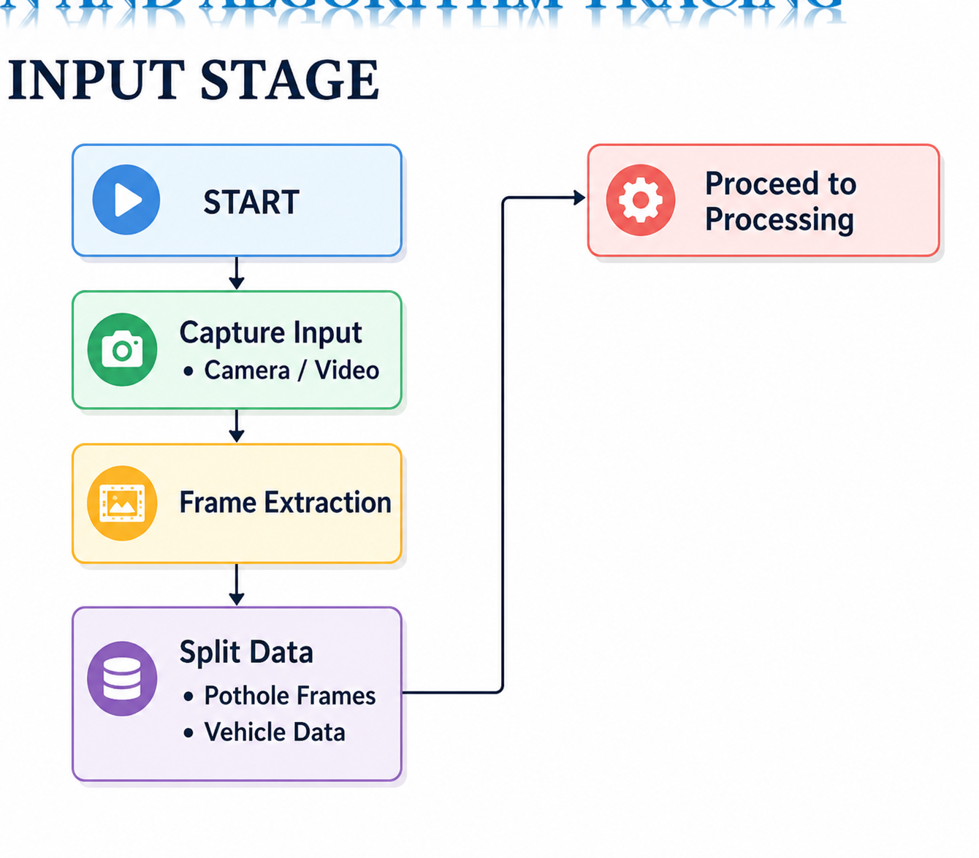
FLOW DIAGRAM :INPUT STAGE
DETAILED DESIGN AND ALGORITHM TRACING

Slide 19
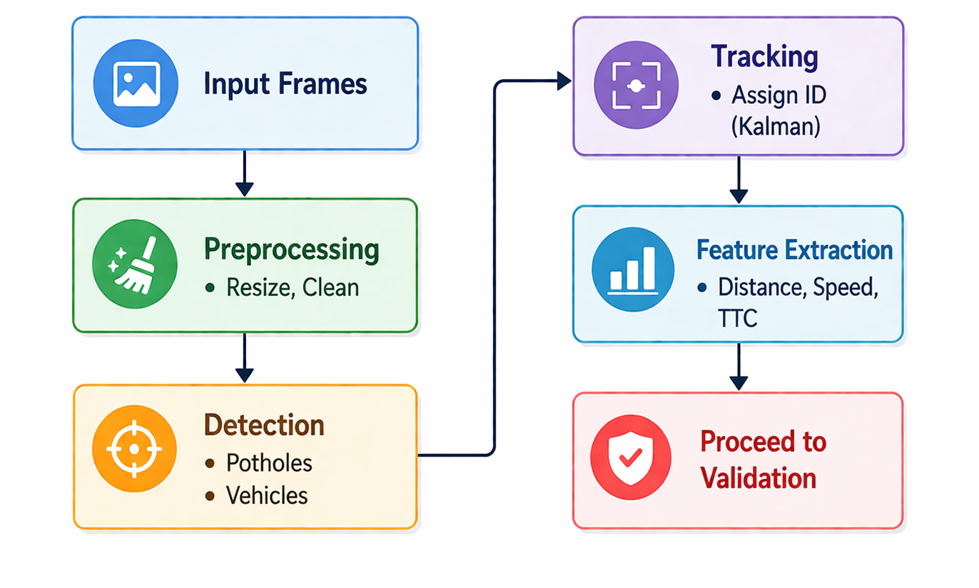
BLOCK DIAGRAM :PROCESSING STAGE

Slide 20
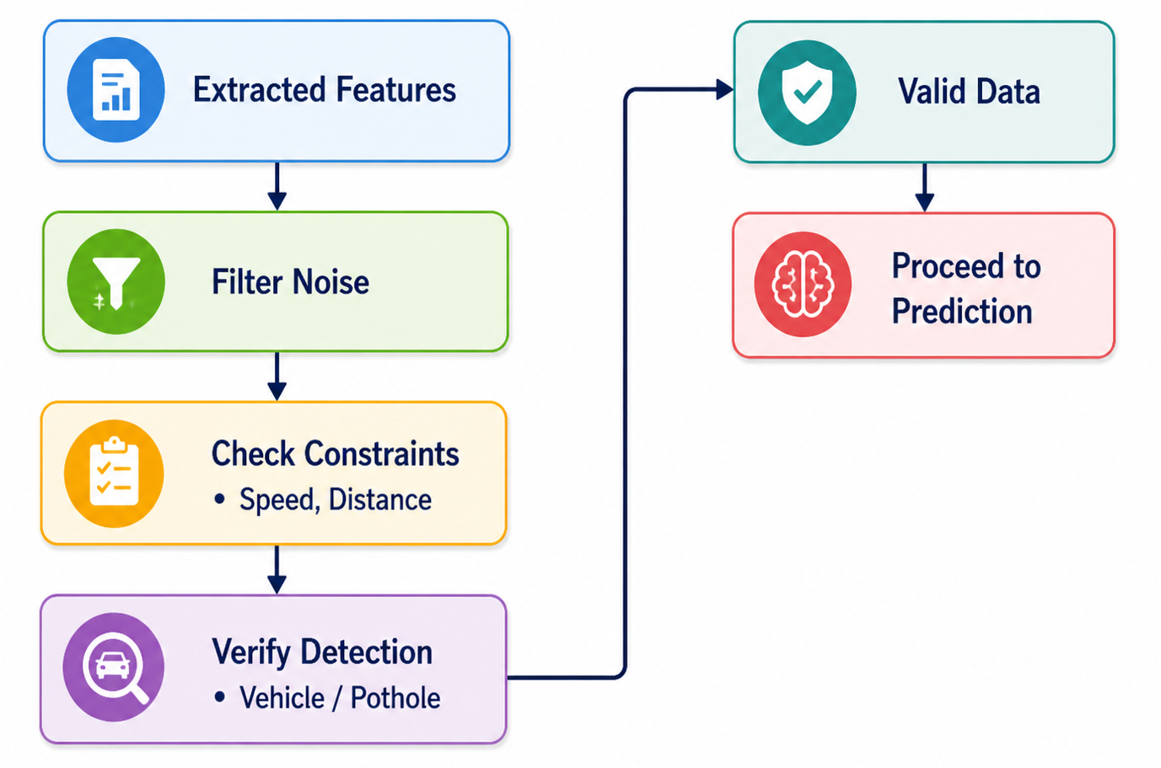
BLOCK DIAGRAM :VALIDATION STAGE

Slide 21
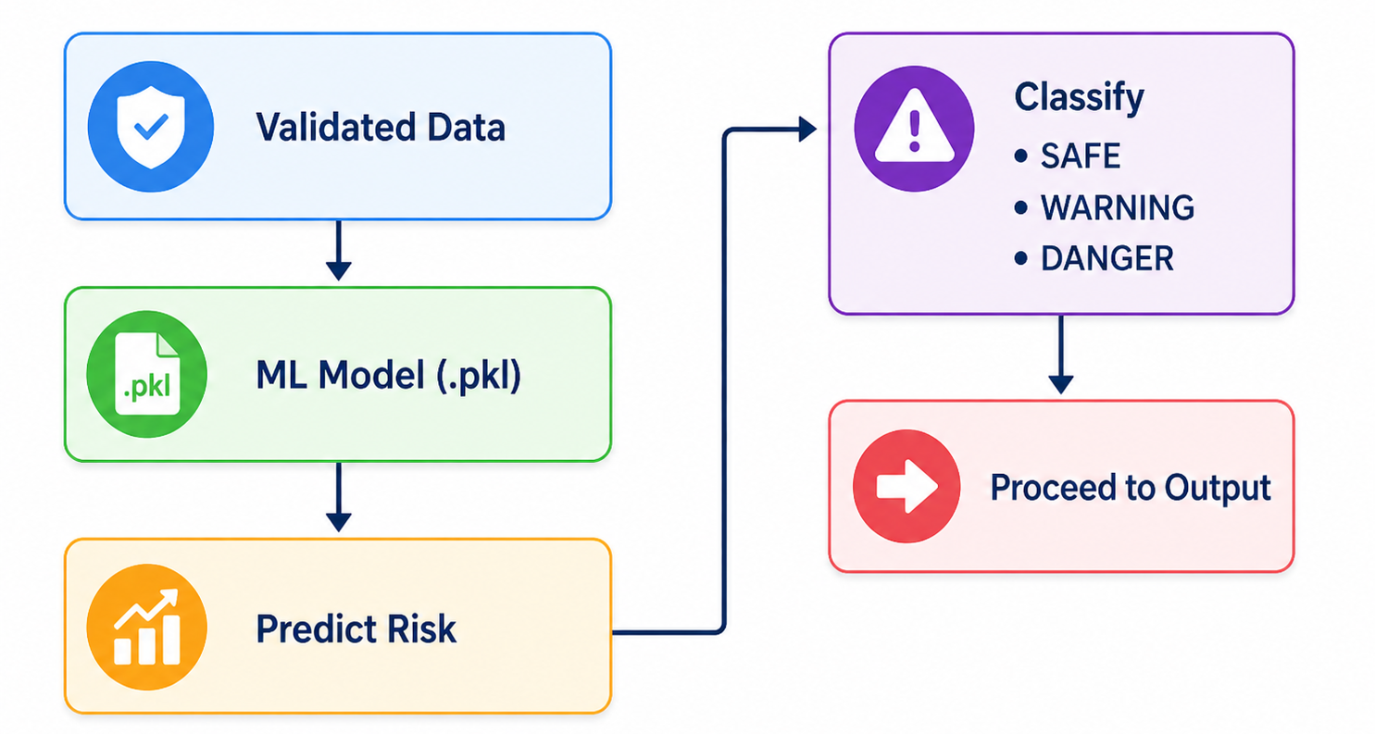
BLOCK DIAGRAM :PREDICTION STAGE

Slide 22
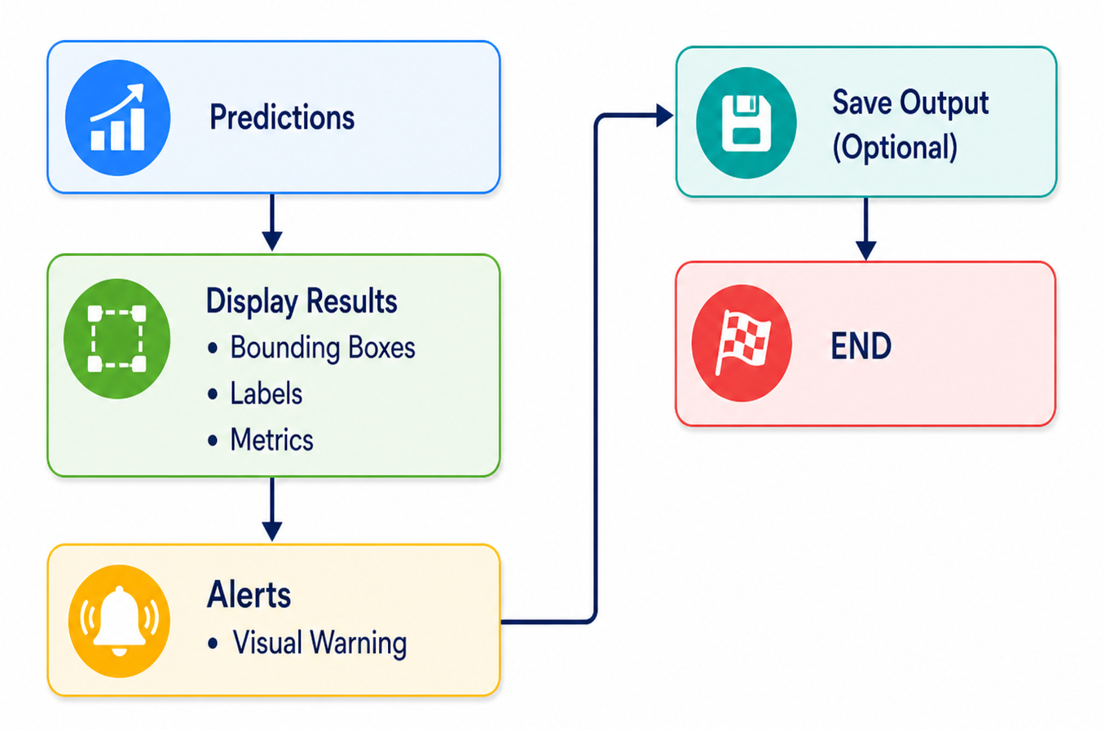
BLOCK DIAGRAM :OUTPUT STAGE

Slide 23
POTHOLE DETECTION SYSTEM
Detailed Design
1. System Overview
The Pothole Detection System uses a YOLOv8-based deep learning model to detect potholes in images/videos. It processes input frames, performs object detection, and outputs bounding boxes with confidence scores.
2. Architecture Components
a) Input Module
Accepts:
  Images
  Video files
  Webcam feed
Converts input into frames for processing
b) Preprocessing Module
Resize frames
Normalize pixel values
Convert into YOLO-compatible format

Slide 24
c) Detection Module (YOLOv8)
Uses trained YOLOv8 model
Detects potholes with:
  Bounding boxes
  Confidence scores
d) Post-processing Module
Filters detections based on confidence threshold
Draws bounding boxes
Counts potholes
e) Output Module
Displays annotated frames
Shows:
  Number of potholes
  Confidence levels
3. Data Flow
Input → Preprocessing → YOLOv8 Model → Detection → Post-processing → Output

Slide 25
ALGORITHM (POTHOLE DETECTION)
1. Start
2. Load YOLOv8 trained pothole model
3. Read input (image/video/webcam)
4. For each frame:
a. Preprocess frame
b. Pass frame to YOLO model
c. Get detections (boxes, confidence)
d. Filter detections based on threshold
e. Draw bounding boxes
f. Count potholes
5. Display/output result
6. End

Slide 26
ALGORITHM TRACING (STEP-BY-STEP)
Example Frame Processing
Frame captured from video
Frame resized to YOLO input size
Model predicts:
Box1 → confidence = 0.85
Box2 → confidence = 0.42
4.Threshold applied (e.g., 0.5):
  Box1 → Accepted
  Box2 → Rejected
5.Bounding box drawn on pothole
6.Counter updated:
Potholes detected = 1
7.Output frame displayed

Slide 27
CAR SYSTEM (Collision AI)
DETAILED DESIGN
1. System Overview
Collision AI is a real-time vehicle collision risk detection system that:
Detects vehicles
Tracks them using Kalman Filter
Extracts motion features
Predicts collision risk using ML model (.pkl)
2. Architecture Components
a) Input Module
Webcam or video input
Frames extracted using OpenCV
b) Detection Module
Two modes:
YOLOv8 (if available)
Background Subtraction (fallback)
Output: Bounding boxes of vehicles

Slide 28
c) Tracking Module (SORT + Kalman Filter)
Assigns unique ID to each vehicle
Tracks movement across frames
Handles:
  Occlusion
  Missed detections
d) Feature Extraction Module
Features include:
Bounding box height & width
Area & aspect ratio
Position (cx, cy)
Speed (pixel change)
Acceleration & jerk
Distance estimation
Time-to-Collision (TTC)
Lane position

Slide 29
e) Risk Prediction Module
Uses trained ML model (.pkl)
Outputs:
SAFE / WARNING / DANGER
f) Visualization Module
Displays:
Bounding boxes
Vehicle ID
Distance, Speed, TTC
Radar view
Alerts (collision warning)
3. Data Flow
Input → Detection → Tracking → Feature Extraction → ML Model → Risk Prediction → Visualization

Slide 30
ALGORITHM (COLLISION)
1. Start
2. Load trained ML model (.pkl)
3. Initialize video capture
4. Initialize detector (YOLO / BG Subtraction)
5. Initialize tracker (SORT)
6. For each frame:
a. Detect vehicles
b. Track vehicles using Kalman Filter
c. For each tracked vehicle:
i. Extract features
ii. Estimate distance & speed
iii. Compute TTC
iv. Predict risk using ML model
d. Draw bounding boxes and metrics
e. Display radar and alerts
7. Show output frame
8. Repeat until exit
9. End

Slide 31
ALGORITHM TRACING (STEP-BY-STEP)
Example Vehicle Tracking
Step 1: Detection
Frame detects:
Vehicle A → bbox (x, y, w, h)
Step 2: Tracking
Assigned ID:
Vehicle A → ID = 1
Step 3: Feature Extraction
From your code:
Height = 120 px
Previous height = 100 px
Speed (pixel) = 120 - 100 = 20

Slide 32
Step 4: Distance Calculation
Distance = (Real Height × Focal Length) / Bounding Box Height
= (1.5 × 700) / 120
≈ 8.75 meters
Step 5: Speed Conversion
Speed (m/s) = pixel_speed × scaling × FPS
Step 6: Time-to-Collision (TTC)
TTC = Distance / Speed
≈ 8.75 / speed
Step 7: ML Prediction
Model input:
[bh, bw, area, aspect, cx, cy, speed, accel, jerk, dist, ttc, ...]
Output: [SAFE = 0.1, WARNING = 0.3, DANGER = 0.6]
Final label: DANGER

Slide 33
Step 8: Visualization
System displays:
Vehicle ID: #1
Distance: 8.7 m
Speed: 32 km/h
TTC: 1.2 s
Risk: DANGER
Step 9: Alert Trigger
If:
TTC < 1.5 → DANGER ALERT
Screen shows:
⚠ COLLISION RISK

Slide 34
IMPLEMENTATION (ALGORITHMS & PSEUDOCODE)
POTHOLE DETECTION SYSTEM
Algorithm – Pothole Detection
1. Start
2. Load YOLOv8 pothole detection model
3. Initialize input source (image/video/webcam)
4. While input is available:
a. Capture frame
b. Resize frame to model input size
c. Normalize pixel values
d. Perform object detection using YOLO model
e. Get bounding boxes, class labels, confidence scores
f. For each detection:
If confidence > threshold:
- Draw bounding box
- Label as pothole
- Increment pothole counter
g. Display annotated frame
5. End

Slide 35
Pseudocode – Pothole Detection
BEGIN
LOAD YOLOv8_model
SET confidence_threshold = 0.5
OPEN video_source
WHILE video is running:
frame ← read_frame()
IF frame is empty:
BREAK
detections ← YOLOv8_model.predict(frame)
pothole_count ← 0
FOR each detection IN detections:
confidence ← detection.confidence
bbox ← detection.bounding_box
IF confidence > confidence_threshold:
DRAW rectangle(frame, bbox)
LABEL frame WITH "Pothole"
pothole_count ← pothole_count + 1
DISPLAY frame WITH pothole_count
END WHILE
END

Slide 36
COLLISION AI SYSTEM
Algorithm – Collision Risk Detection
1. Start
2. Load trained ML model (.pkl)
3. Initialize video capture
4. Initialize detector (YOLO / Background Subtraction)
5. Initialize tracker (SORT with Kalman Filter)
6. For each frame:
a. Detect vehicles
b. Track vehicles across frames
c. For each tracked vehicle:
i. Extract features
ii. Estimate distance
iii. Compute speed
iv. Calculate Time-to-Collision (TTC)
v. Predict risk using ML model
d. Smooth predictions using history buffer
e. Draw bounding boxes and metrics
f. Display alerts (SAFE / WARNING / DANGER)
7. Repeat until exit
8. End

Slide 37
Pseudocode – Collision AI
BEGIN
LOAD model_pkg FROM .pkl file
model ← model_pkg["model"]
INITIALIZE video_capture
INITIALIZE detector ← YOLO OR background_subtraction
INITIALIZE tracker ← SORT()
WHILE video is running:
frame ← read_frame()
IF frame is empty:
BREAK
detections ← detector(frame)
tracked_objects ← tracker.update(detections)

Slide 38
FOR each track IN tracked_objects:
bbox ← track.get_bbox()
features, dist, speed, ttc, approaching ← extract_features(bbox)
IF speed > max_speed:
CONTINUE
probabilities ← model.predict_proba(features)
label ← argmax(probabilities)
confidence ← max(probabilities)
UPDATE track.risk_history WITH label
label ← majority_vote(track.risk_history)
COMPUTE lane_position
STORE metrics:
distance, speed, ttc, risk, confidence
DRAW bounding_boxes WITH metrics
DRAW radar visualization
DISPLAY frame
END WHILE
RELEASE resources
END

Slide 39
Feature Extraction Pseudocode
FUNCTION extract_features(bbox, previous_state):
x, y, w, h ← bbox
area ← w * h
aspect_ratio ← w / h
center_x ← (x + w/2) / frame_width
center_y ← (y + h/2) / frame_height
speed_pixel ← current_height - previous_height
acceleration ← speed_pixel - previous_speed
jerk ← acceleration - previous_acceleration
distance ← (real_height * focal_length) / h
speed_mps ← convert(speed_pixel)
IF object approaching:
ttc ← distance / speed
ELSE:
ttc ← large_value
RETURN feature_vector, distance, speed, ttc
END FUNCTION

Slide 40
Tracking Algorithm (SORT + Kalman Filter)
BEGIN
FOR each frame:
PREDICT next position of all tracks
COMPUTE IoU between detections and predictions
MATCH detections to tracks
FOR matched pairs:
UPDATE Kalman Filter
FOR unmatched detections:
CREATE new track
FOR unmatched tracks:
INCREMENT miss count
REMOVE tracks with high miss count
RETURN active tracks
END

Slide 41
Risk Decision Logic
IF TTC < 1.5 OR distance < 4:
RISK = DANGER
ELSE IF TTC < 3 OR distance < 10:
RISK = WARNING
ELSE:
RISK = SAFE
Prediction Smoothing
ADD current_label TO history_buffer
FINAL_LABEL ← most_frequent_label(history_buffer)

Slide 42
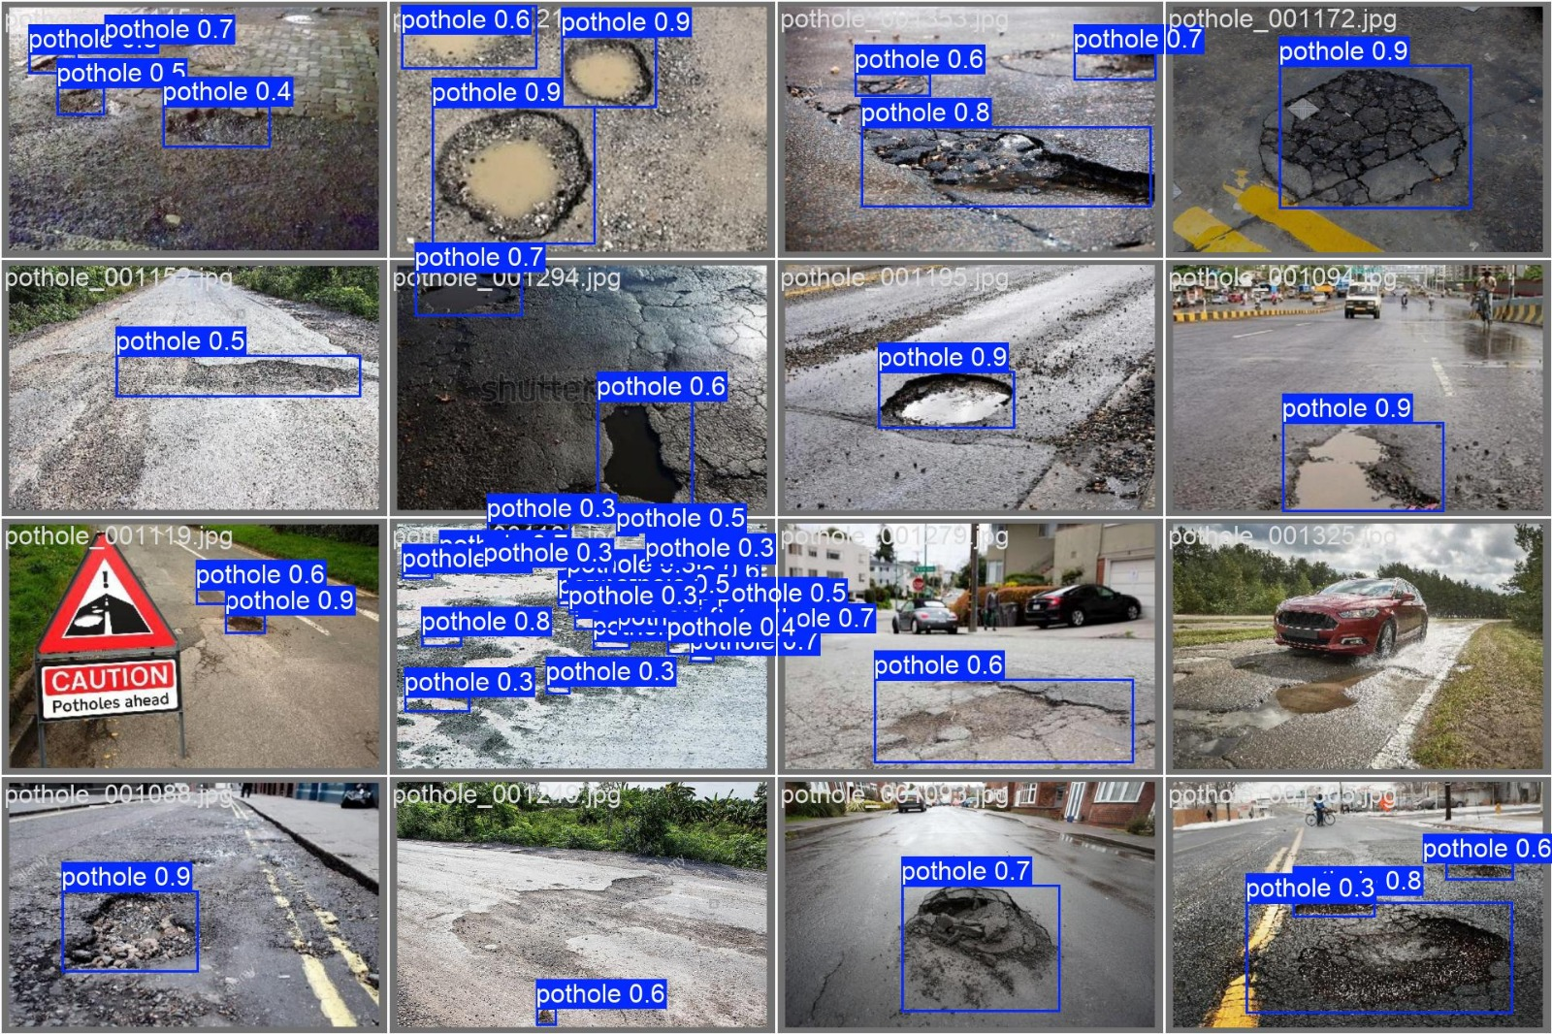
RESULTS AND ANALYSIS
Fig 2 : Pothole detected images for different road condition

Slide 43
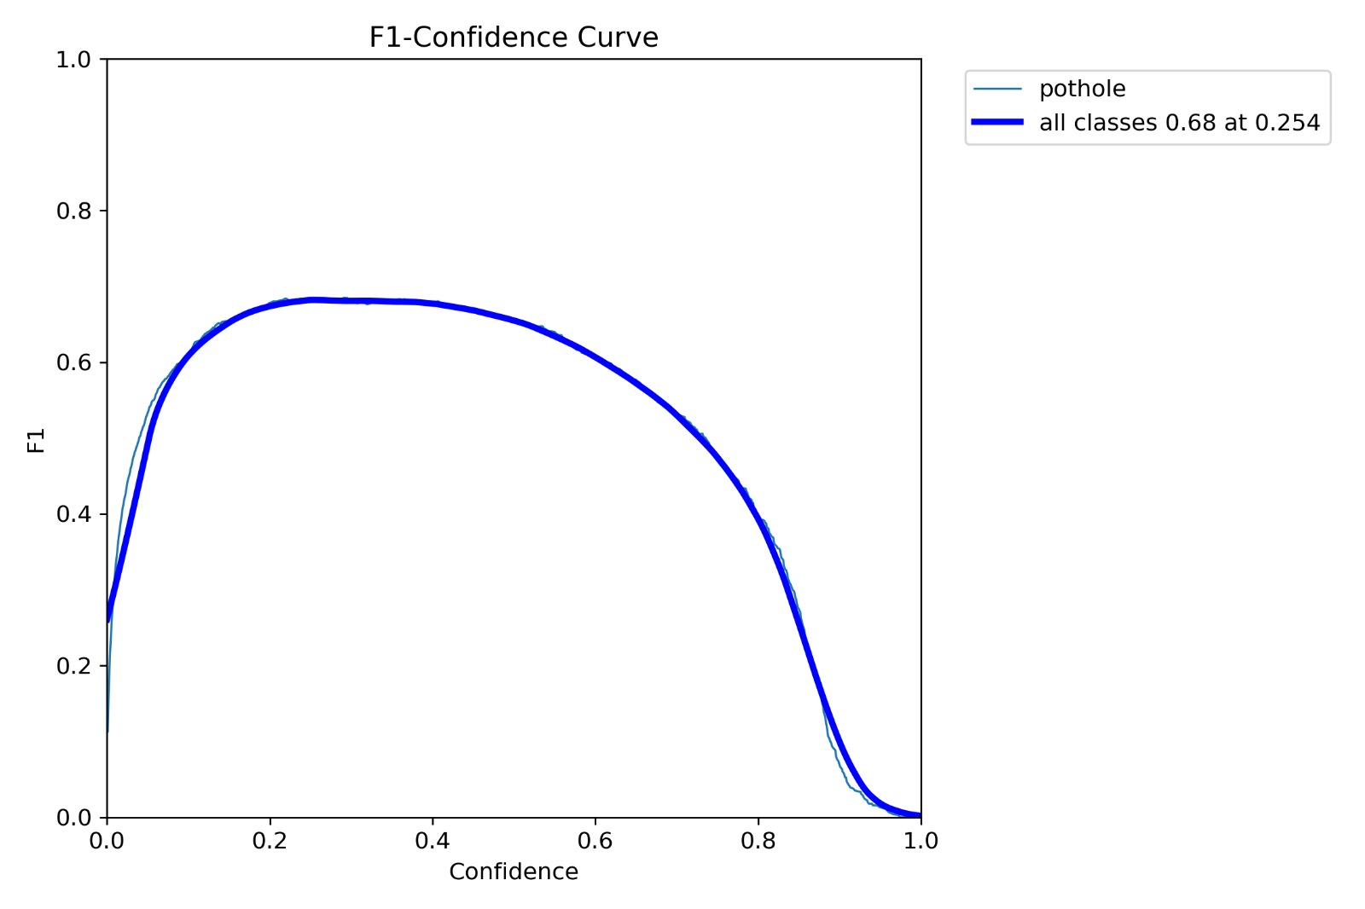
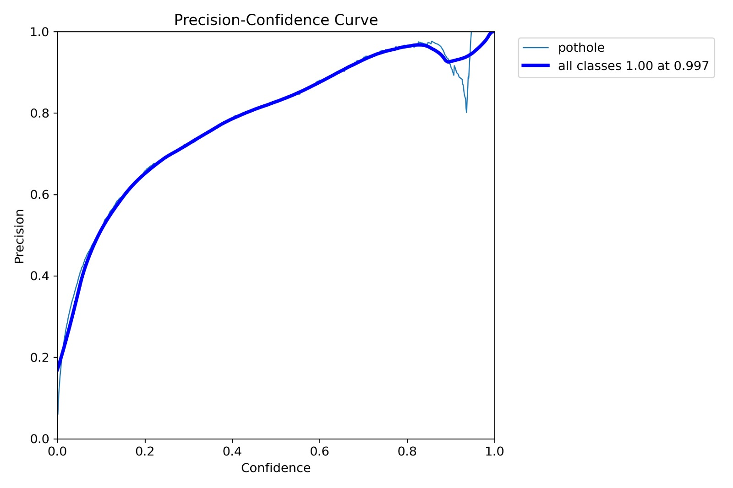
Fig 3 : F1-confidence curve and precision-confidence curve

Slide 44
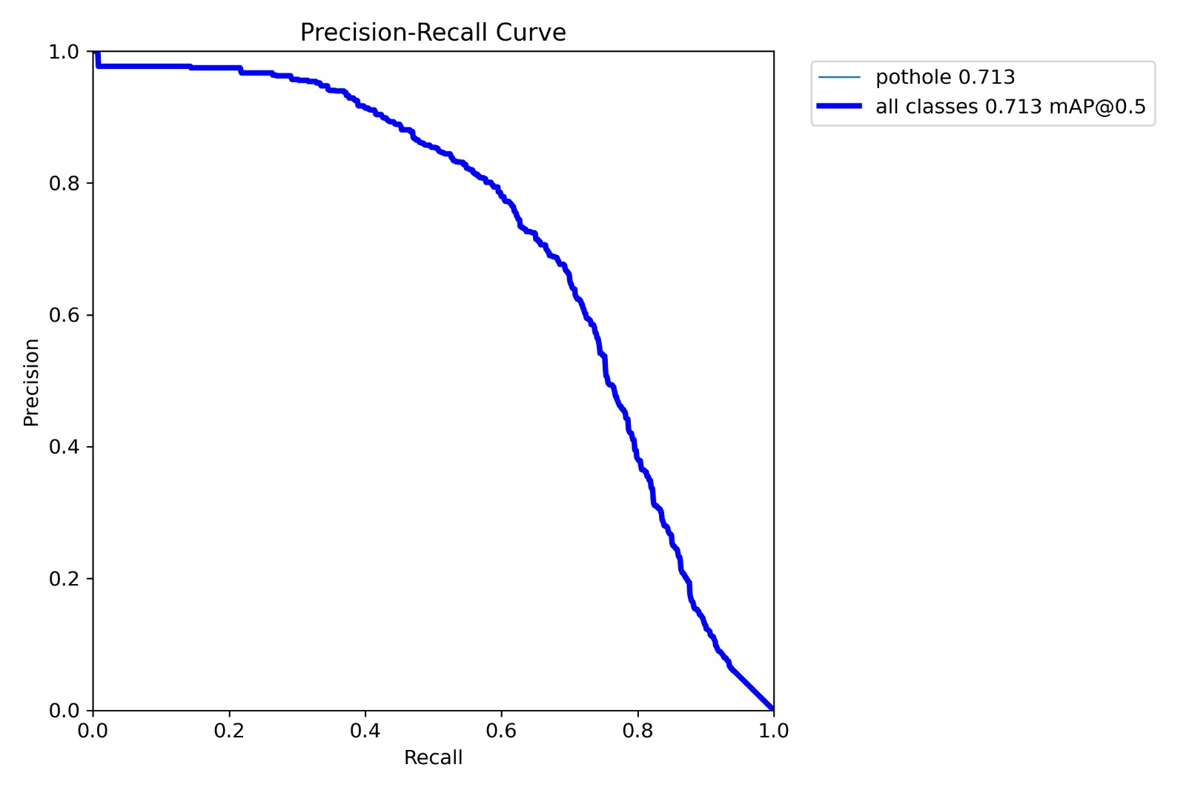
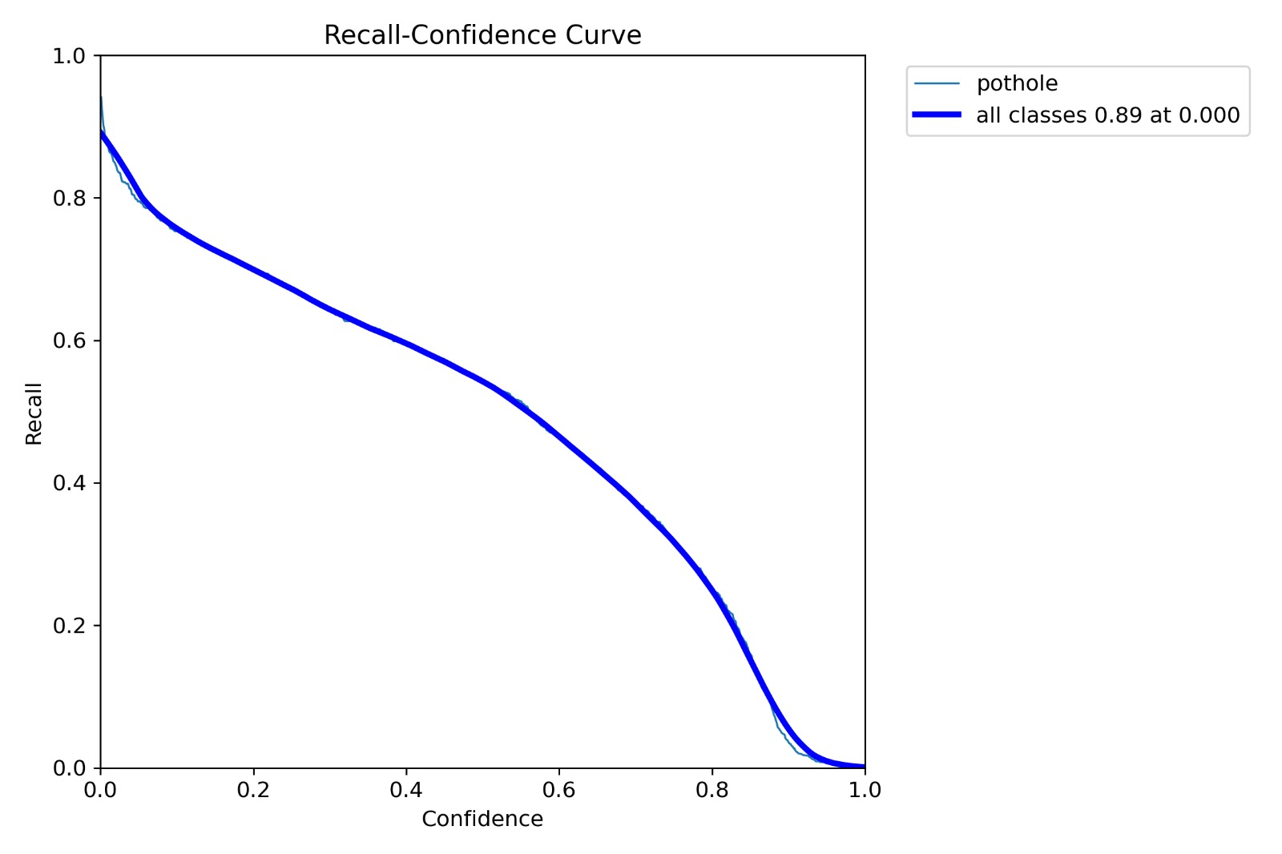
Fig 4 : Precision-Recall curve and Recall-Confidence Curve

Slide 45
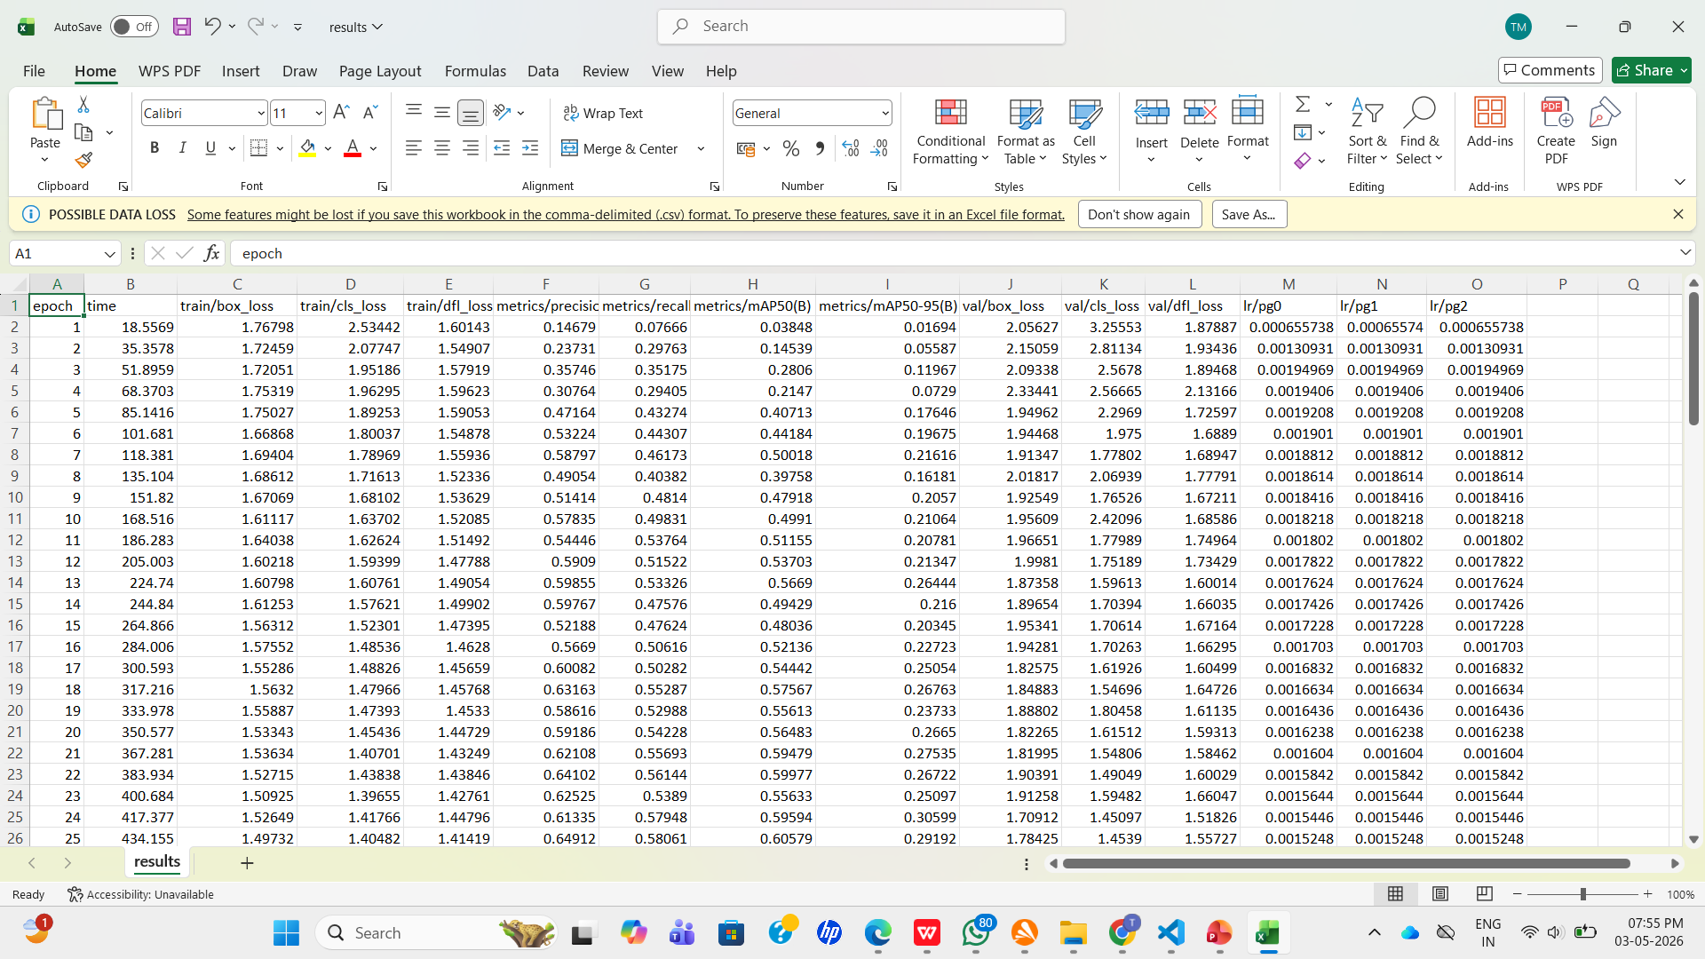
Fig 5 : Results CSV File Image

Slide 46
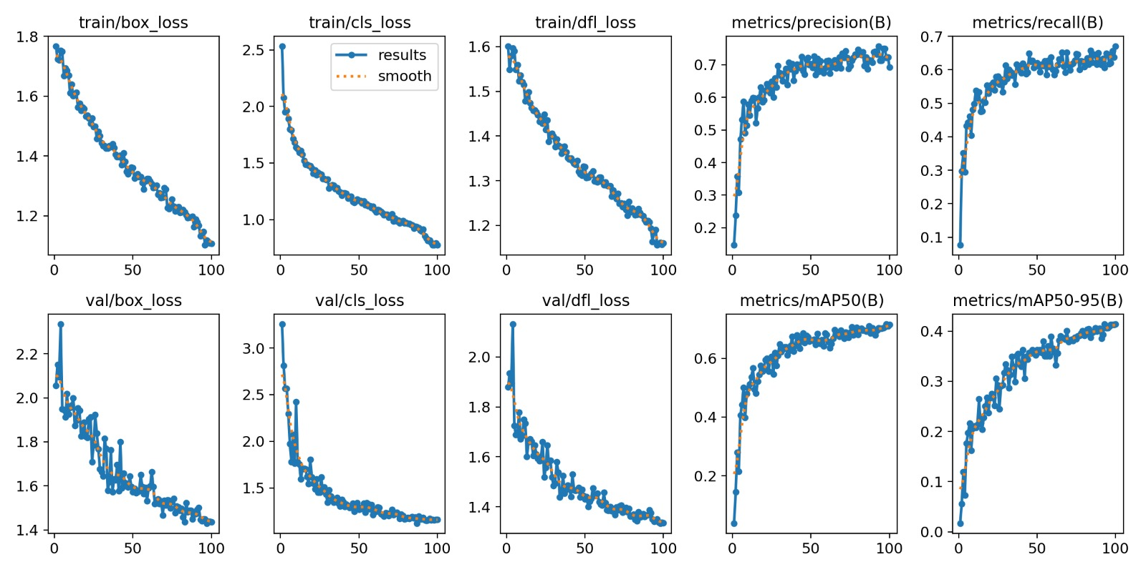
Fig 6: YOLOv8 Training Performance Metrics for Pothole Detection

Slide 47
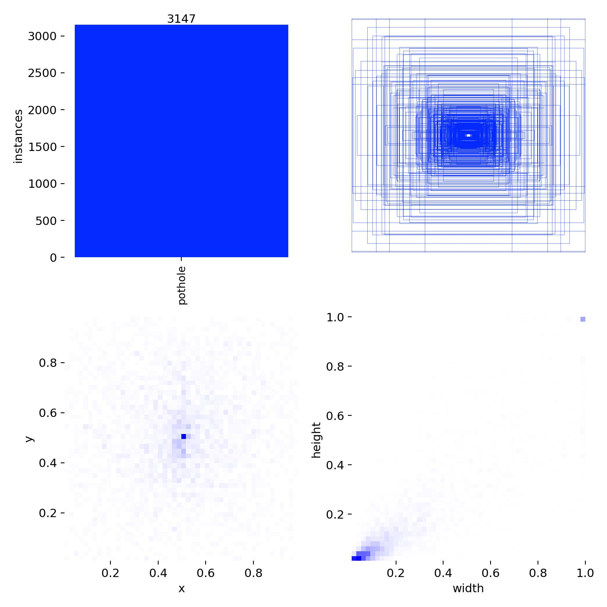
Fig 7 : Pothole Dataset Analysis and Label Distribution

Slide 48
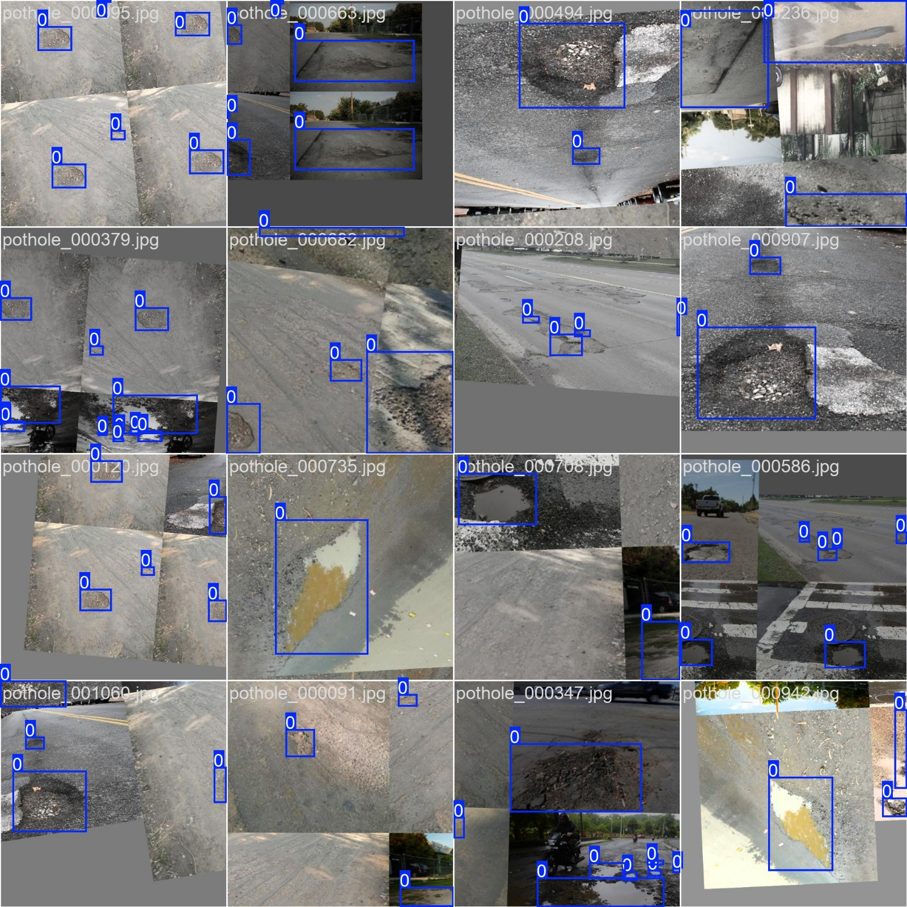
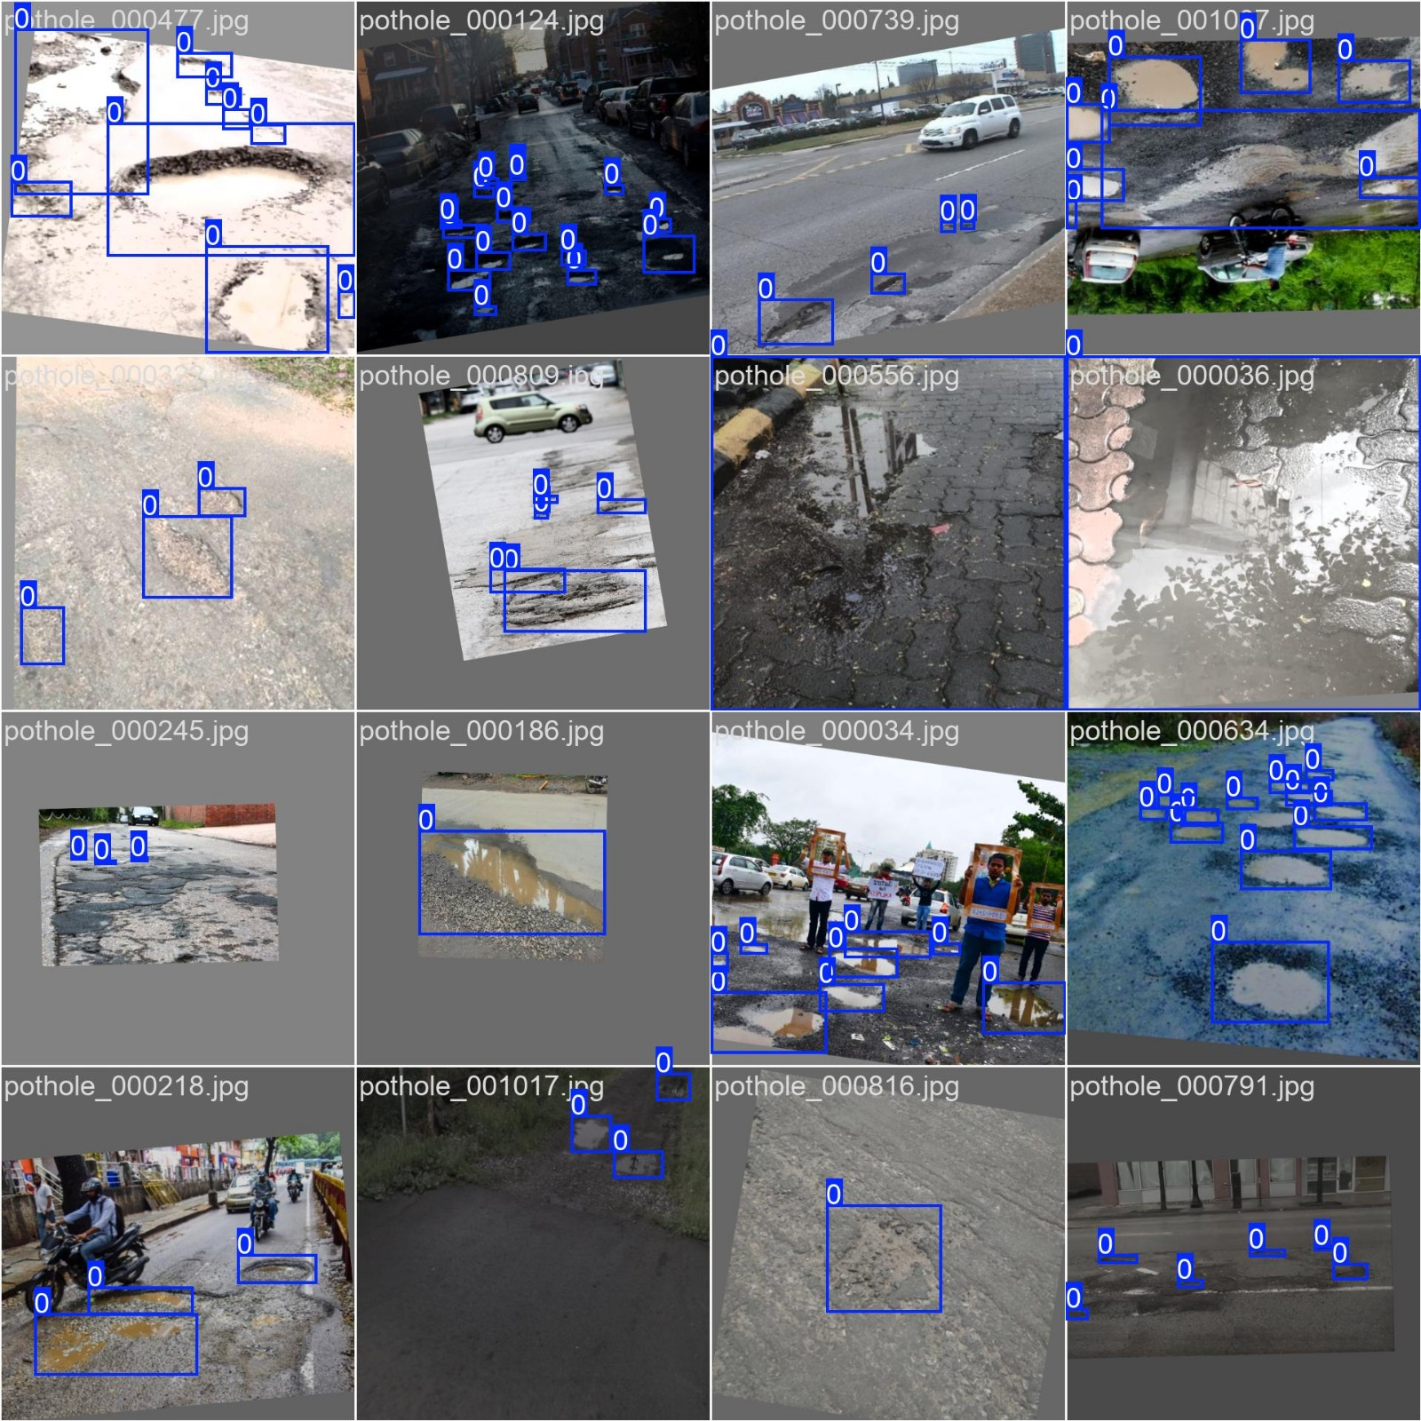
Fig 8 : Pothole detected images

Slide 49
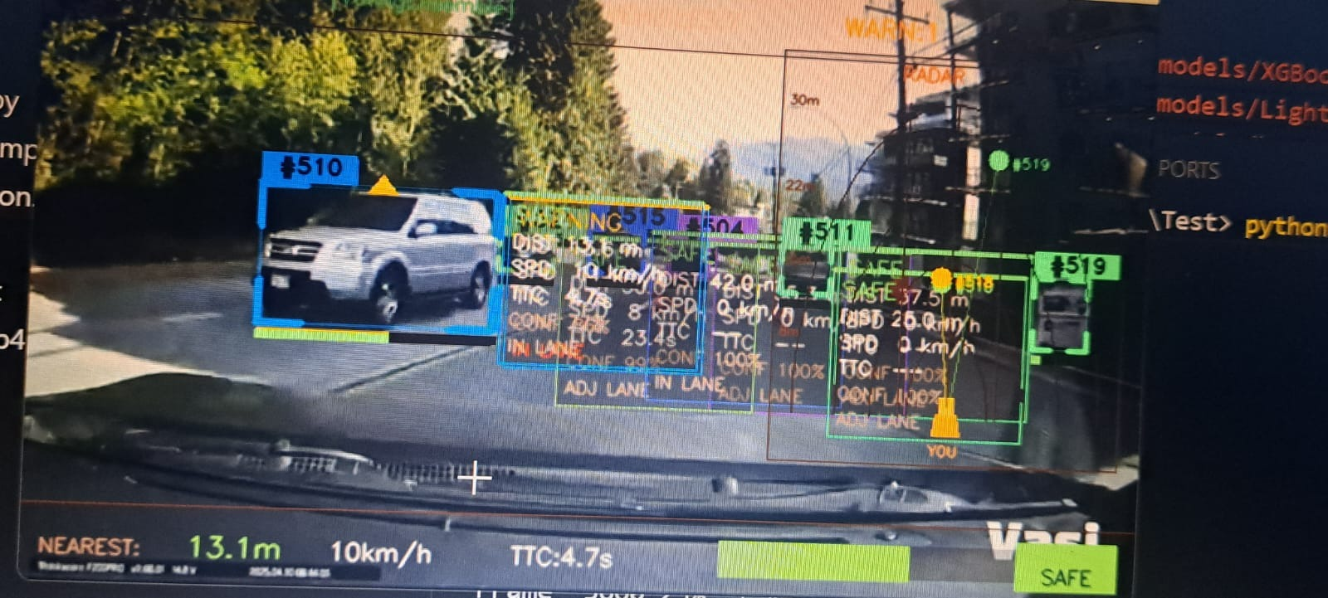
Fig 9: Real-Time Collision Detection and Risk Visualization Output

Slide 50
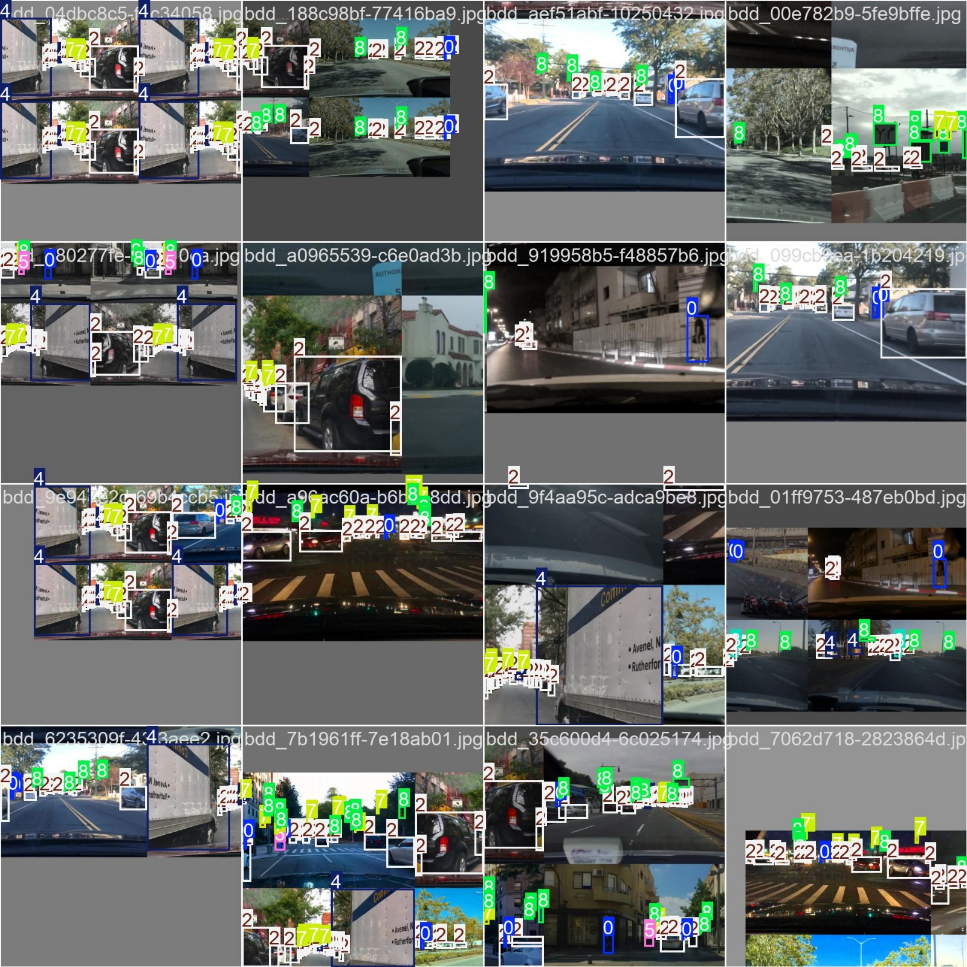
Fig 10: Annotated Training Dataset with Bounding Boxes

Slide 51
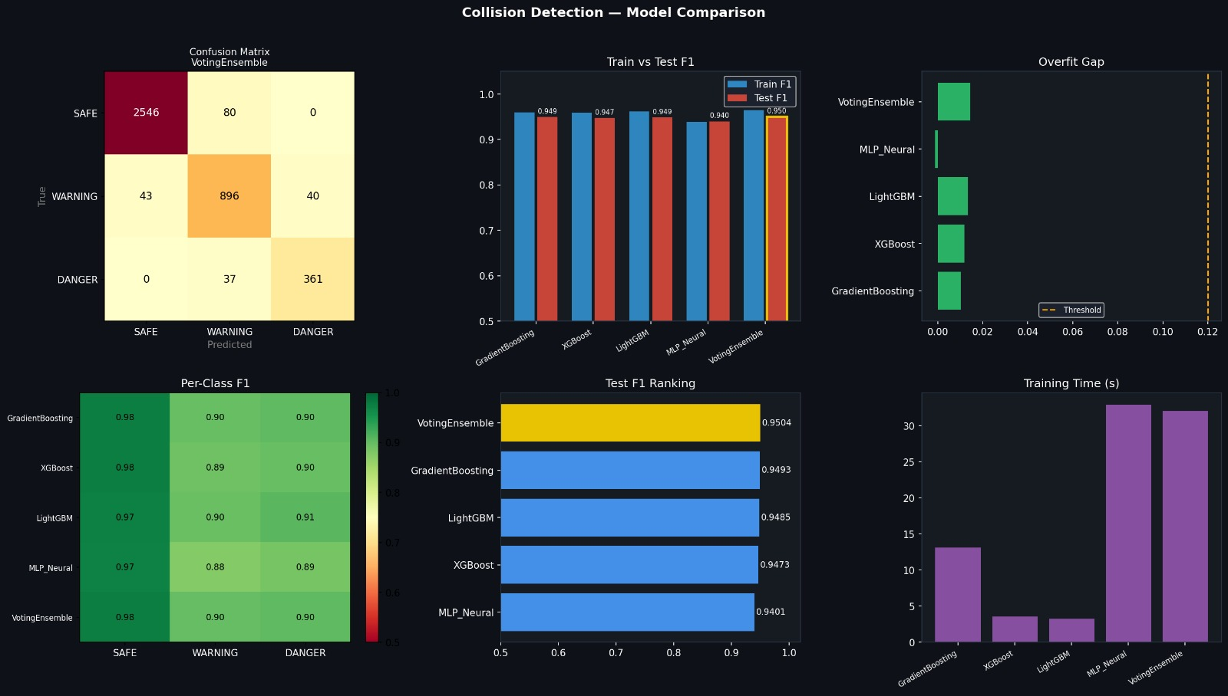
Fig 11: Confusion Matrix voting Ensemble And Train vs Test F1 graph

Slide 52
Fig 12: Overfit gap and Per Class F1 graph

Slide 53
Fig 13 : Test F1 Ranking and Training time Graph

Slide 54
CONCLUSION
The system integrates pothole detection and collision risk prediction into a unified real-time road safety solution. The pothole module, based on YOLOv8, accurately detects road damages from video input. The CollisionAI module detects vehicles, tracks movement, and analyzes their behavior effectively.
The system uses features like distance estimation, speed calculation, and Time-to-Collision (TTC) to assess risk levels. It classifies situations into safe, warning, and danger while providing real-time alerts and visualization. Overall, the solution is efficient, scalable, and suitable for smart driving assistance applications.

Slide 55
FUTURE WORK
Integrate lane detection and road segmentation to improve contextual understanding and reduce false alerts.
Deploy the system on embedded hardware (e.g., edge devices) for real-time in-vehicle implementation.
Enhance model accuracy by training on larger and more diverse datasets under different weather and lighting conditions.
Incorporate driver behavior analysis (fatigue, distraction detection) for a more comprehensive safety system.
Develop a mobile or cloud-based dashboard for live monitoring, analytics, and alert notifications.

Slide 56
REFERENCES
[1] Razak, W., Noman, A., & Ale, S. Z., “Deep Learning YOLOv8 Fog-based Mobile Object Detection,” Proceedings of the International Conference on Computer Technology, pp. 1–6, 2024.
[2] Neeza, R., Ahmadi, A., & Zulfikli, A., “Deep Learning YOLOv8 Fog-based Mobile Object Detection,” Proceedings of the International Conference on Engineering Technology, pp. 45–52, 2025.
[3] Mengyang, X., Xu, C., & Zhao, S., “Dynamic Obstacle Avoidance Using Artificial Potential Field,” IEEE Transactions on Robotics, vol. 37, no. 2, pp. 123–130, 2021.
[4] Bhusanpally, Y., Vanga, S., & Reddy, K., “SROI+ GPS-GSM Pothole Detection System,” Journal of Image Processing, vol. 15, no. 3, pp. 200–210, 2024.
[5] Rajitha, V., Vanka, S., & Sandesh, B., “Pothole Detection Using Edge Detection,” Proceedings of the IEEE International Conference on Signal Processing, pp. 78–85, 2024.
[6] Houzhuai, C., Chen, Z., & Zhang, H., “Enhanced Damage Detection Using YOLO with RD2020,” Computer Vision Analysis, vol. 28, no. 4, pp. 450–460, 2024.

Slide 57

THANK YOU!

